Slide 1
Scottish Household Survey Analysis Factors influencing Neighbourhood Ratings and Community Belonging
Emma Menzies

Slide 2
Scottish Household Survey
Annual cross-sectional survey of random people in private residences across Scotland
In 2019 10,577 householders agreed to take part
Running since 1999
Redesigned in 2011 and 2020
Aims to provide policy relevant data and be useful to stakeholders
Introduction

Slide 3
Definitions
Scottish Household Survey: Annual cross-sectional survey of random people in private residences across Scotland
Neighbourhood rating: "THINKING NOW ABOUT THE NEIGHBOURHOOD YOU LIVE IN, HOW WOULD YOU RATE IT AS A PLACE TO LIVE? If pressed, define 'your neighbourhood' as: 'the street you live in and the streets nearby' (urban) or 'the local area' (rural).”
(1) Very good (2) Fairly good (3) Fairly poor (4) Very poor No opinion
Community belonging: "HOW STRONGLY DO YOU FEEL YOU BELONG TO YOUR IMMEDIATE NEIGHBOURHOOD?“
(1) Very strongly (2) Fairly strongly (3) Not very strongly (4) Not at all strongly Don't know
SIMD quintile: Scottish Index of Multiple Deprivation. This categorises 6,976 small areas of Scotland based on income, employment, education, health, access to services, crime, and housing.
Social rented: Managed by public authorities and housing associations with support from the Scottish Government.
Introduction

Slide 4
Key Questions and Motivation
Does access to greenspace increase neighbourhood ratings and/or community belonging?
Which areas have the best and worst ratings?
What factors influence neighbourhood ratings and community belonging?
Erasmus Happiness Economics Research Organisation (EHERO) have found that good neighbourhoods and community belonging have a positive impact on life satisfaction.
https://networkofwellbeing.org/2017/03/16/importance-neighbourhoods-wellbeing/
The Scottish Government are also committed to empower communities and improve quality of life in neighbourhoods.
https://www.gov.scot/policies/community-empowerment/
Introduction

Slide 5
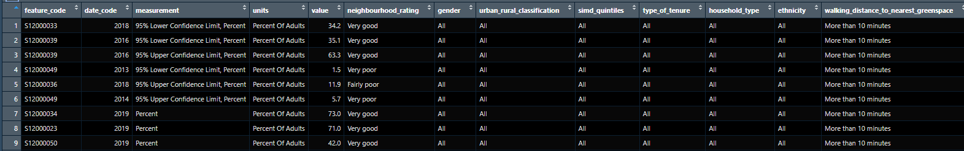
Data Cleaning
Row 9: 42% of adults in a particular council area in 2019 with a walking distance of more than 10 minutes to their nearest greenspace rated their neighbourhood “Very good”.
STEPS
Join council area names based on feature code
Factor the neighbourhood ratings
Create a column to calculate a score for each row based on the rating and value
N = ~38,055 - 43,611
Data Cleaning and Exploration
Notes:
Measurements: percent, upper and lower confidence limits
Years: 2013-2019

Slide 6
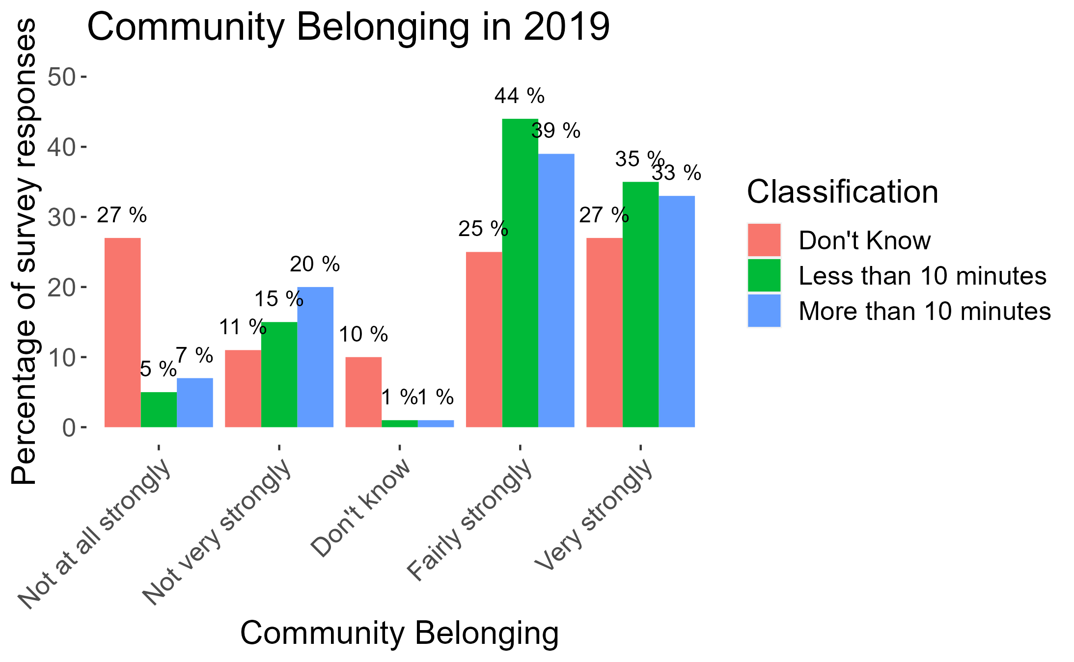

Data Exploration
Create visualisations
Walking distance to nearest greenspace
Data Cleaning and Exploration
Notes:
First made a function to easily visualise responses.
Issues ->
only 2019, perhaps it changes over time?
no “overall” score to see which group rated the highest
Whole of Scotland, what if different areas differ?

Slide 7
1. Does access to greenspace increase neighbourhood ratings and/or community belonging?
Explored through R Shiny

Slide 8
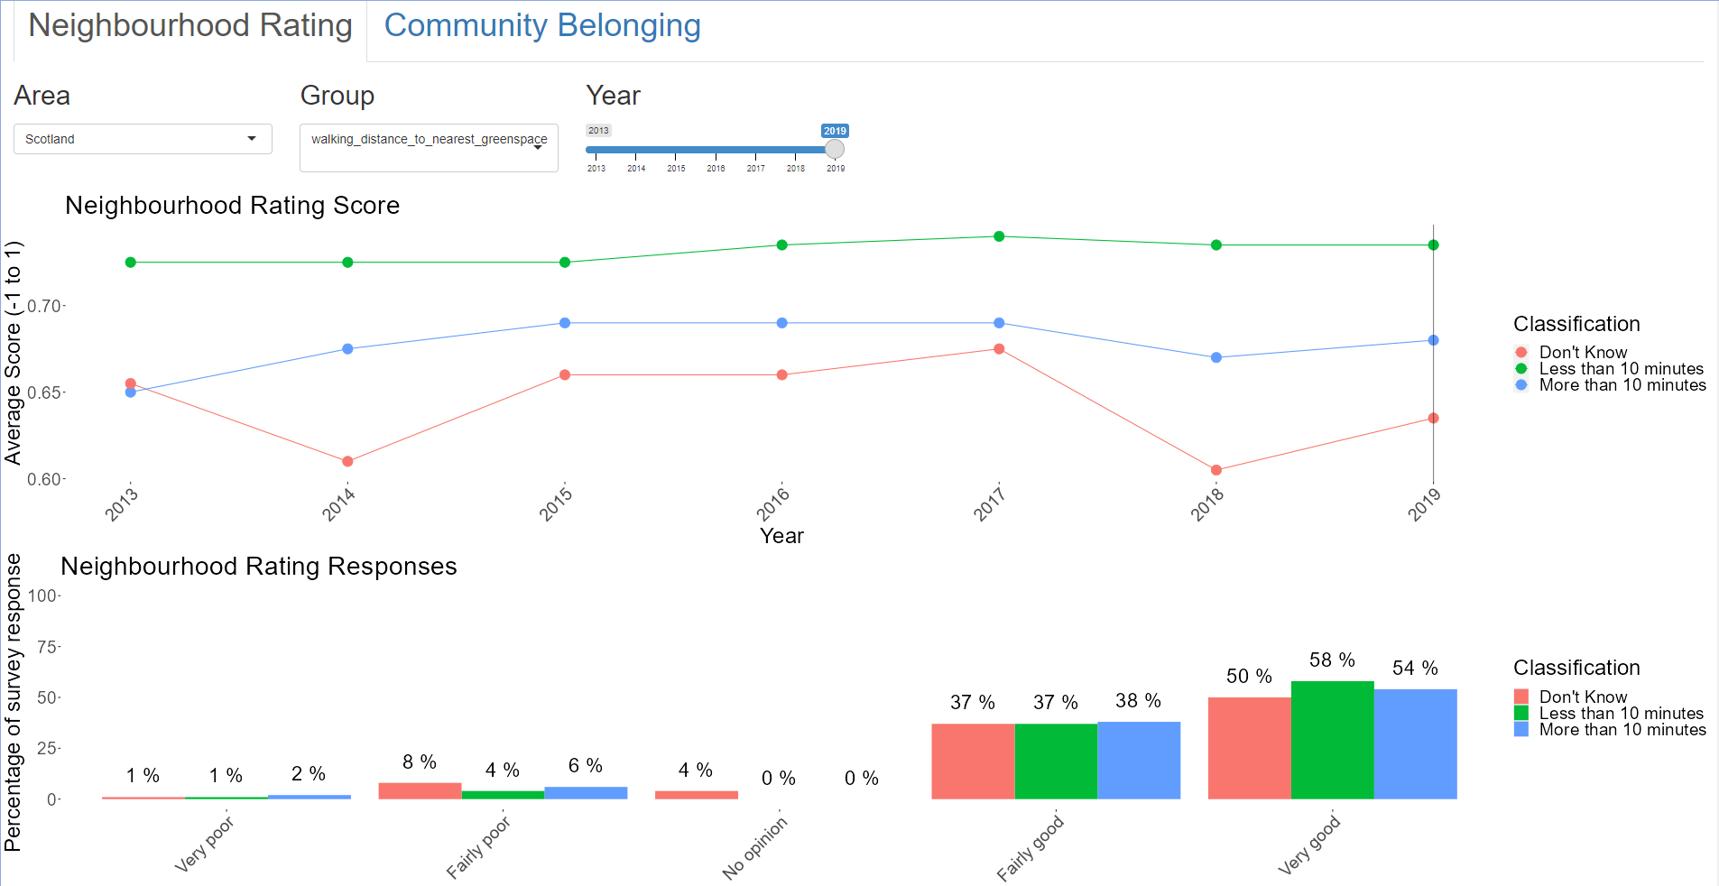
1. Does access to greenspace increase neighbourhood ratings and/or community belonging?

Slide 9
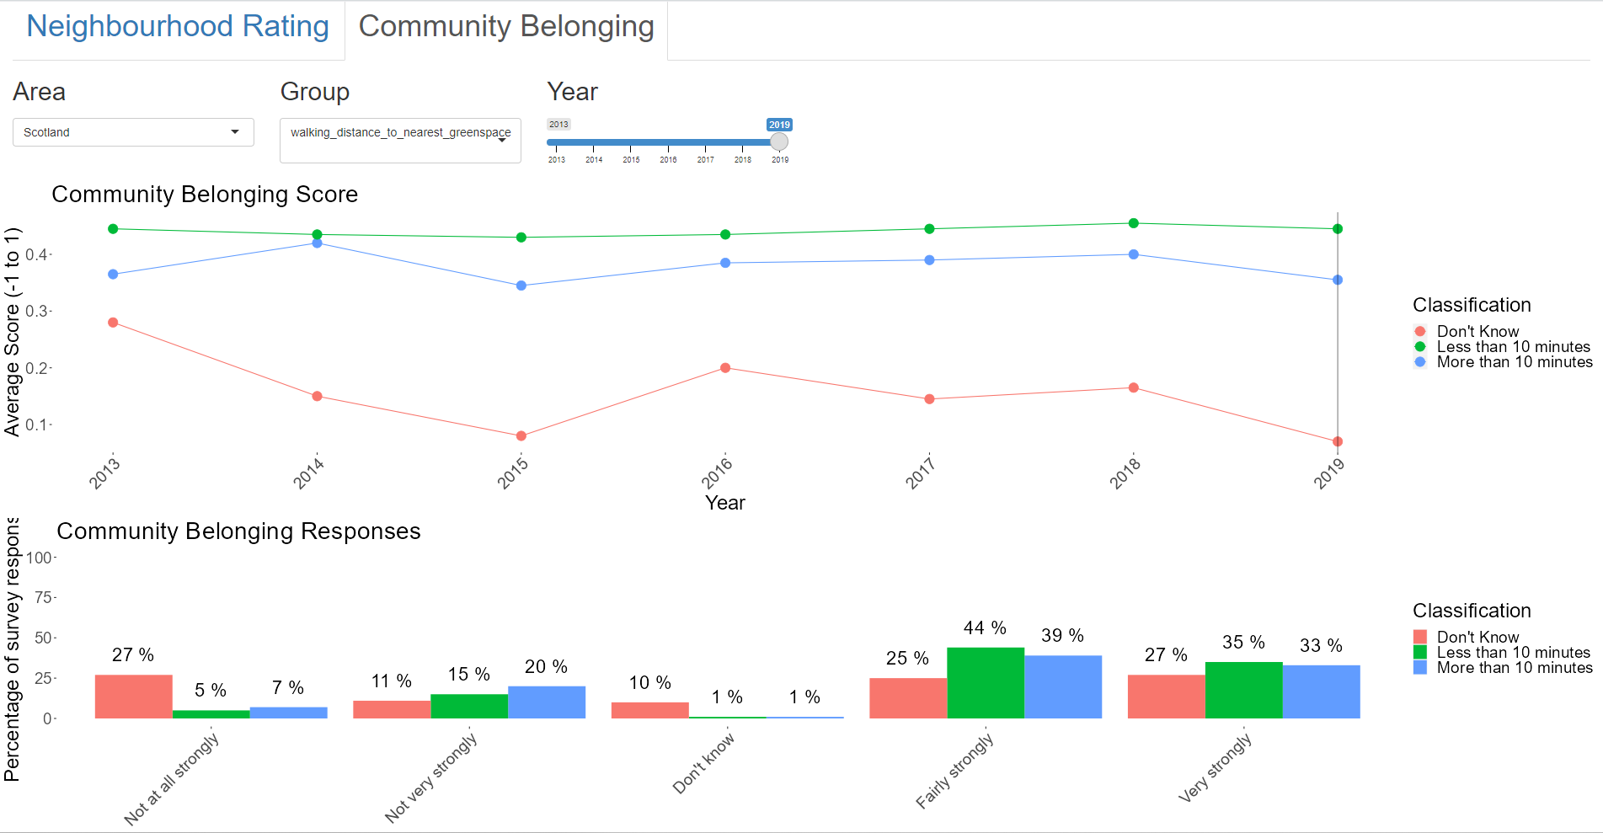
1. Does access to greenspace increase neighbourhood ratings and/or community belonging?
Notes:
Access to greenspace does increase neighbourhood ratings AND community belonging.

Slide 10
2. Which areas have the best and worst ratings?
Explored through maps

Slide 11
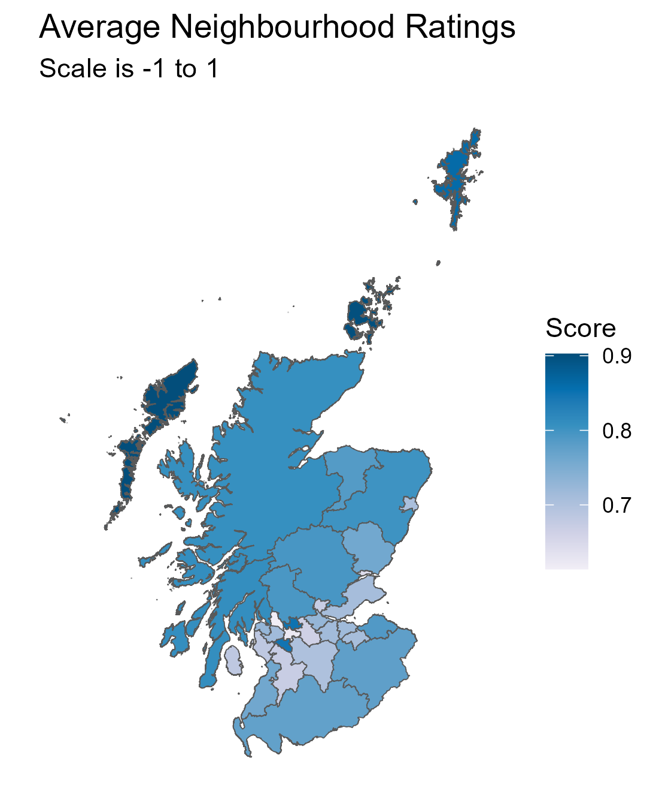
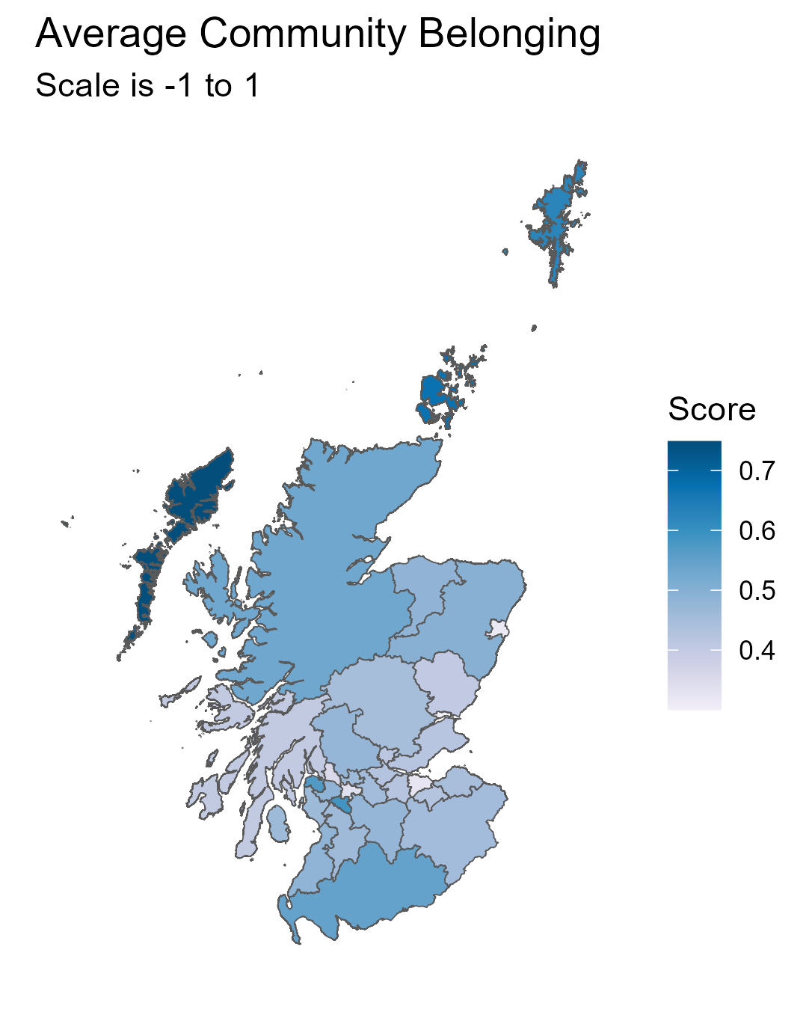
Differences Across Scotland
Changes from 2013 - 2019
Top Rated Areas | Neighbourhood | Community
Outer Hebrides
Orkney Islands
Shetland Islands
East Renfrewshire
Highland
+4%
+5%
-8%
-9%
-2%
-0%
-0%
-16%
-4%
-5%
Bottom Rated Areas | Neighbourhood | Community
Dundee City
Aberdeen City
Glasgow City
West Dunbartonshire
Clackmannanshire
+4%
+23%*
-3%
-19%*
+0%
-5%
-10%*
+0%
+6%
+13%
* Biggest magnitude of change across Scotland
2. Which areas have the best and worst ratings?

Slide 12
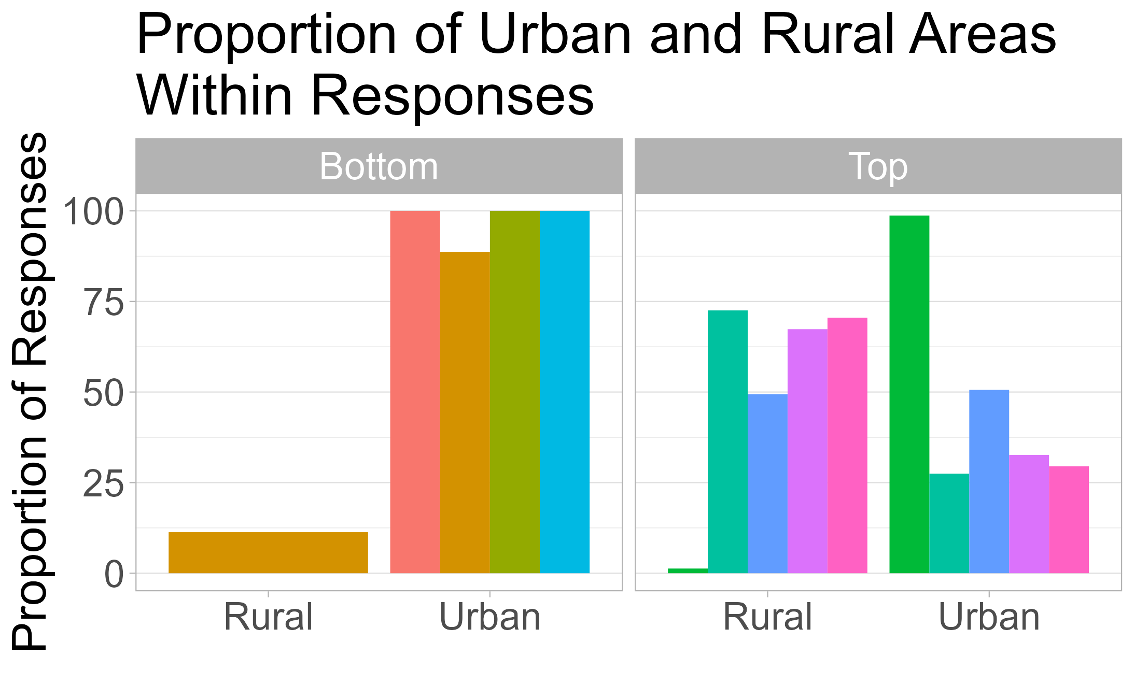
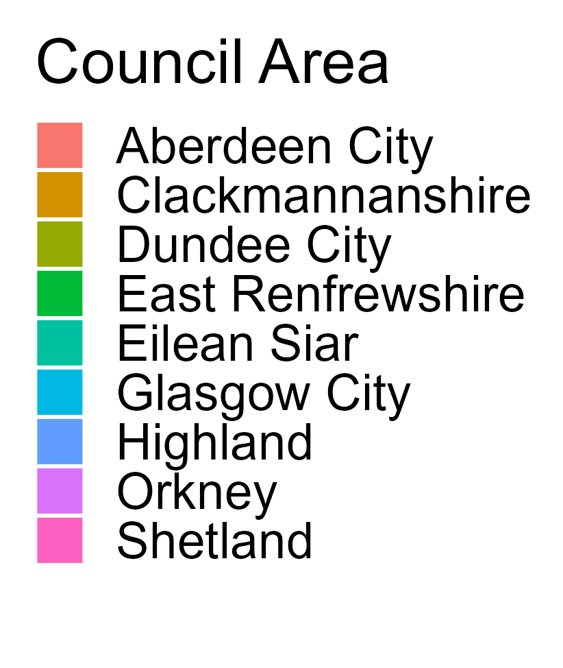
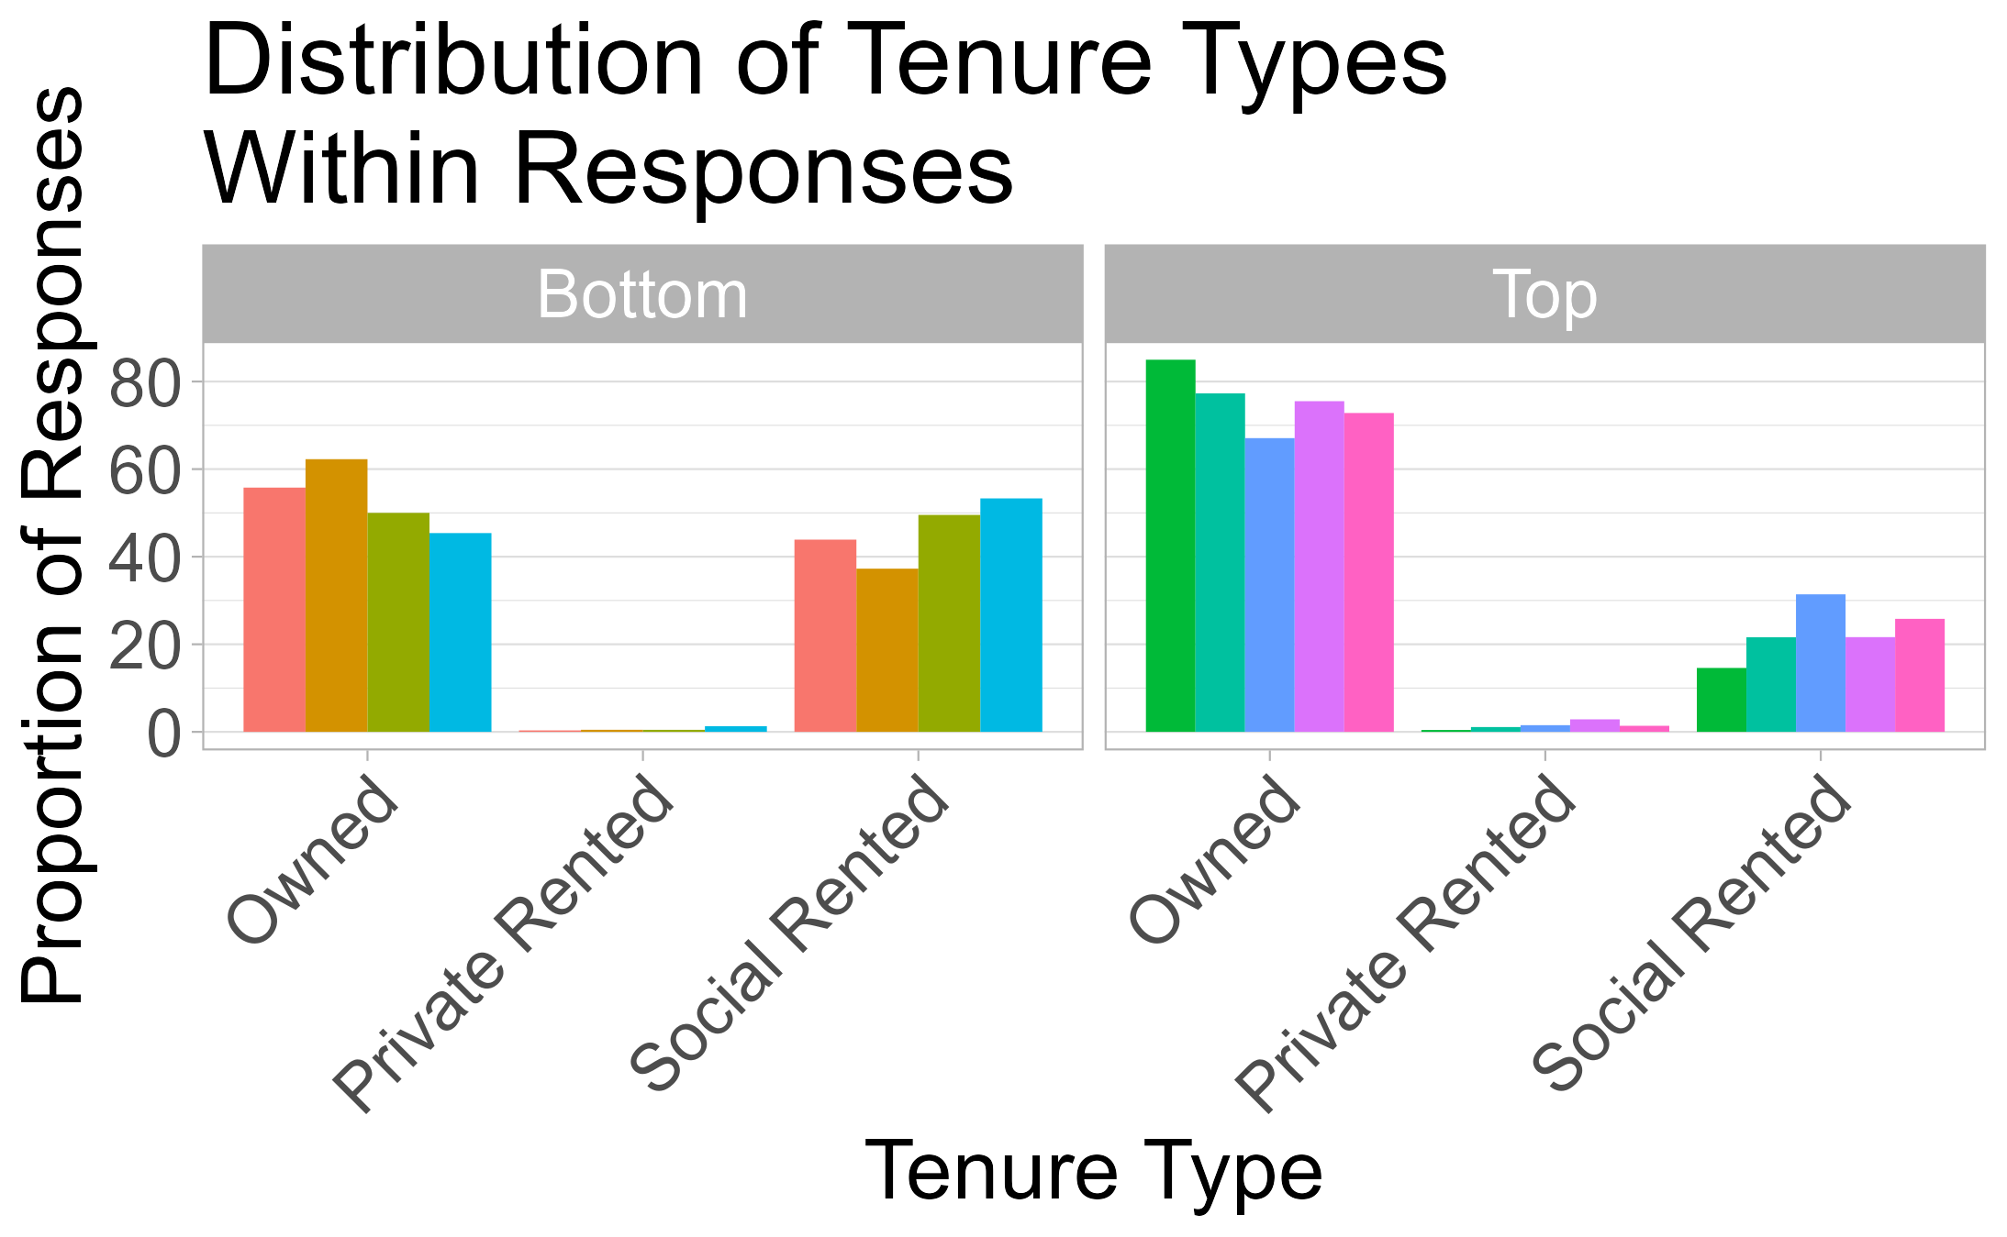
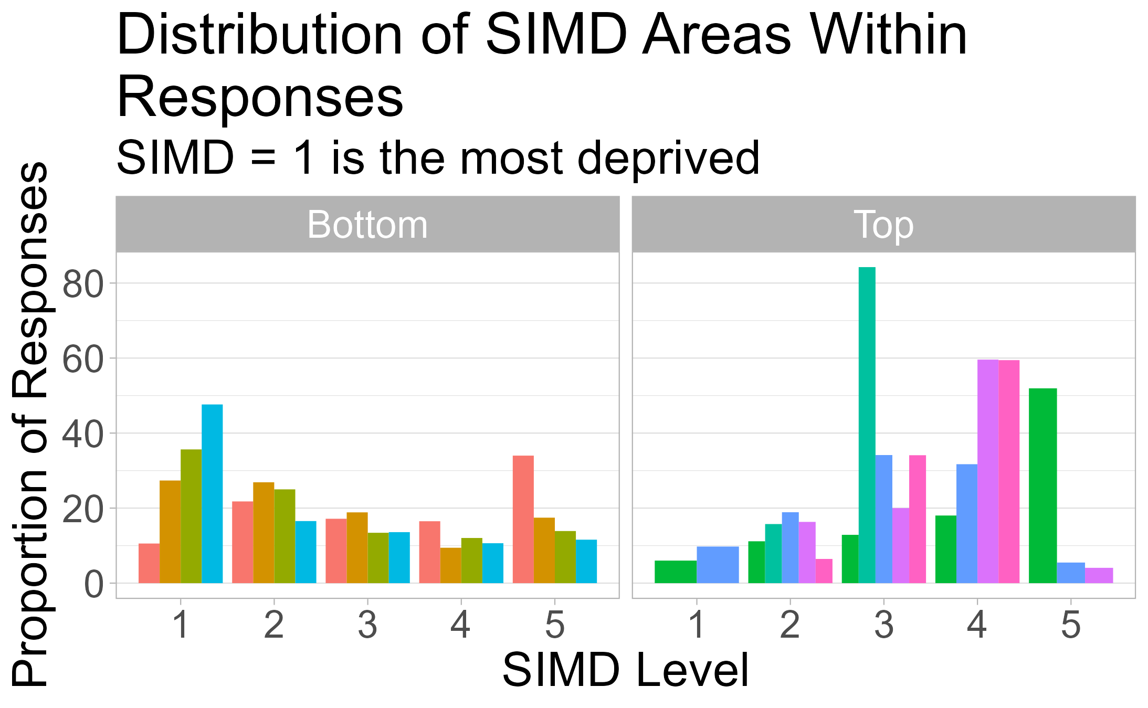
What makes these areas different?

Slide 13
3. What factors influence neighbourhood ratings and community belonging?
Explored through R Shiny and Visualisations

Slide 14
Key Factors Influencing Neighbourhood Ratings and Community Belonging
Highest Ratings
Rural areas
Access to greenspace less than 10-minute walk
80% least deprived
Homeowners
Pensioners
White
Lowest Ratings
Urban areas
Access to greenspace more than 10-minute walk
20% most deprived
Private or social rented
Adult only households
Non-white ethnicity
Summary: Should target urban areas, with low SIMD and high proportions of social renting
3. What factors influence neighbourhood ratings and community belonging?

Slide 15
Conclusion and Action
Increasing access to greenspace where possible may help improve neighbourhoods and communities
Further study could look at what the highest rated areas are doing well, particularly compared to the lowest rated areas
Further investigation should focus on how neighbourhoods and communities can be improved for:
Areas of deprivation (SIMD)
Urban areas
Those renting (private or social)
Families
Non-white ethnicities
Conclusion

Slide 16
Further Ideas
Modelling to identify key factors and the impact they have
Explore raw survey data to identify other things that impact the ratings
Explore the demographics of the highest and lowest rated areas
Understand the sample sizes to better understand the results
Explore the confidence limits and what they tell us about the data
Conclusion

Slide 17
Reflection
Aggregated data makes modelling or statistical analysis very difficult
Planning and understanding the question(s) is key
Making notes and writing down your thinking and research sources as you go is very useful!
Reflection

